Slide 1
Download and Statistics of TCGA data from GDC portal
Yue Wu
08/02/2016

Slide 2
Contents
Background
Methods
Results

Slide 3
Contents
Background
Methods
Results

Slide 4
Background
TCGA(The Cancer Genome Atlas) is a multidimensional program invlolved 33 cancer types and more than 11,000 patients.
This program include data of genomics, expression, epigenomics, clinical, and image.
At present, most of the data is on GDC(Genomic Data Commons)
http://cancergenome.nih.gov

Slide 5
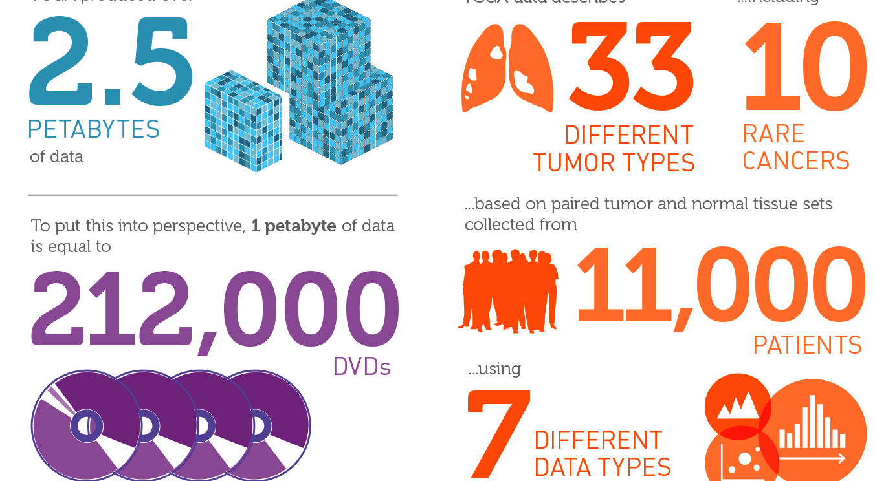
Background
http://cancergenome.nih.gov

Slide 6
Data categories
Archive: CNV, Gene expression, Raw data, SNV, Clinical, DNA Methylation, Biospecimen, Protein expression, Structure arrangement.
New TCGA portal: SNV, Transcriptome Profiling, Raw sequencing data, CNV, Biospecimen, Clinical.
Notes: Gene expression(Transcripttome Profiling): Gene expression, isoform expression, miRNA expression.
Somatic MAF are open:https://gdc-docs.nci.nih.gov/Data/Release_Notes/Data_Release_Notes/
http://cancergenome.nih.gov
Notes:
TCGA has changed a lot since the program was finished.
Old TCGA data is stored in the Archive.
The most obvious differences showed as green.

Slide 7
Variaion
Changes in categories, methods, and quantity of data.
Previous download methods temporally failed: TCGA-Assembler.
Some previous functions failed: UUID-Barcode relationship sites.
Some clinical data absence: pathology, Imaging.
Notes:
No longer useful: https://tcga-data.nci.nih.gov/uuid/uuidws/mapping/json/barcode/
https://tcga-data.nci.nih.gov/uuid/uuidws/mapping/xml/barcode/
Also the format of clinic data now is quite strange XML.

Slide 8
Contents
Background
Methods
Results

Slide 9
Methods
Search and Retrieval(Curl and Json)
Download(gdc-client)
Workflow

Slide 10
Search and Retrieval
Curl is an open source command line tool and library for transferring data with URL syntax.
It could be used for GDC API.
Example format: $curl 'https://gdc-api.nci.nih.gov/files?filters=&size=&format=&pretty=true&from=’
Json(JavaScript Object Notation) is a lightweight data-interchange format.
It could be used as filter for search data.
I changed it to URI(uri_escape) to apply it.
Ex: {"op":\t"=",\n\t"content":\t{\n\t"field":\t"cases.clinical.gender",\n\t"value":\t["male"]\n\t}\n}\n
Notes:
Endpoint, format(TSV), fields, filters, size and from
Showhow
API:Application Program Interface

Slide 11
SHOW UP
Json: {"op":"and","content":[{"op":"in","content":{"field":"cases.case_id","value":["7a918706-c697-4cef-9661-346c5a612ff8"]}}]}
URI:%7B%22op%22%3A%22and%22%2C%22content%22%3A%5B%7B%22op%22%3A%22in%22%2C%22content%22%3A%7B%22field%22%3A%22cases.case_id%22%2C%22value%22%3A%5B%227a918706-c697-4cef-9661-346c5a612ff8%22%5D%7D%7D%5D%7D
Command: curl 'https://gdc-api.nci.nih.gov/files?filters=%7B%22op%22%3A%22and%22%2C%22content%22%3A%5B%7B%22op%22%3A%22in%22%2C%22content%22%3A%7B%22field%22%3A%22cases.case_id%22%2C%22value%22%3A%5B%227a918706-c697-4cef-9661-346c5a612ff8%22%5D%7D%7D%5D%7D&size=23&format=TSV&pretty=true&from=1'
Notes:
Json-uri: http://text-rescue.com/string-escape/percent-url-encoding-tool.html

Slide 12
Download
gdc-client is standard data transfer tool for GDC.
Format: $gdc-client download uuid –d path
SHOWUP: gdc-client download 26136dcd-9007-4a74-b362-21f0c37da898 -d /Users/mikeaalv/Documents/TCGA/test/

Slide 13
Workflow
Project information and general file information
Case information
Aliquot information
File information and download
Local biospecimen file
Build the uuid and barcode relationship, and aliquot usage

Slide 14
Workflow
Project information and general file information
Case information
Aliquot information
File information and download
Local biospecimen file
Build the uuid and barcode relationship, and aliquot usage

Slide 15
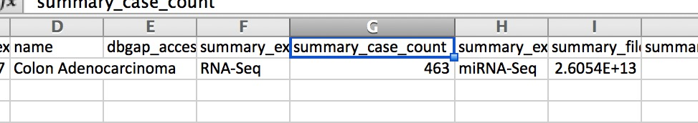
Project information
curl 'https://gdc-api.nci.nih.gov/projects/TCGA-COAD?expand=summary,summary.experimental_strategies,summary.data&pretty=true&format=TSV'

Slide 16
Workflow
Project information and general file information
Case information
Aliquot information
File information and download
Local biospecimen file
Build the uuid and barcode relationship, and aliquot usage

Slide 17
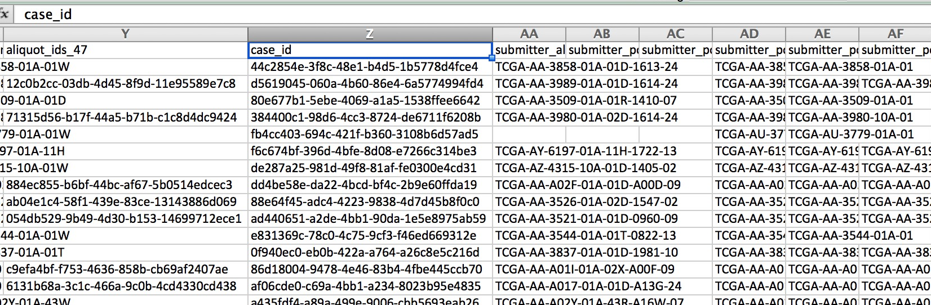
Case information
curl 'https://gdc-api.nci.nih.gov/cases?filters=$filter&size=463&format=TSV&pretty=true&from=1’
Filter here is for searching case in this project
Notes:
Filter here is for searching case in this project

Slide 18
Workflow
Project information and general file information
Case information
Aliquot information
File information and download
Local biospecimen file
Build the uuid and barcode relationship, and aliquot usage

Slide 19
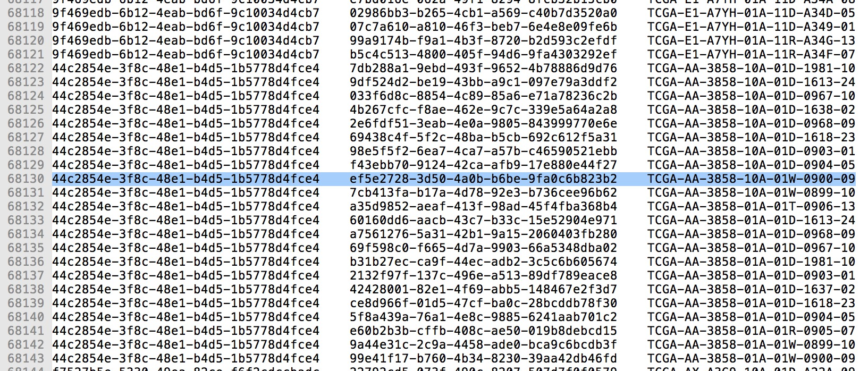
Aliquot information
Use local file to get aliquot_id and search each aliquot corresponding files.
curl 'https://gdc-api.nci.nih.gov/files?filters=$filter_aliquo&size=19&format=TSV&pretty=true&from=1\’
Filter here is for searching files in this aliquot.
Case_id aliquot_id barcode

Slide 20
Contents
Background
Methods
Results

Slide 21
Results
General information of TCGA
Results of this program.

Slide 22
Results
General information of TCGA
Results of this program.

Slide 23
Access (general)
Data TCGA portal
TCGA Archive
data category | open | controlled
SNV | 0 | 91154
Transcriptome profiling | 57698 | 0
Raw sequencing data | 0 | 45988
CNV | 33134 | 0
Biospecimen | 11356 | 0
Clinical | 11168 | 0
Data category | open | controlled
SNV | 135 | 74522
gene expression | 133855 | 0
Raw sequencing | 12640 | 97606
Raw microarray | 120258 | 28918
CNV | 96107 | 94254
Biospecimen | 11295 | 0
Clinical | 54200 | 0
DNA methylation | 13448 | 47
Protein expression | 8391 | 0
Structrue arrangement | 0 | 3045
Other | 2920 | 7258
Website: https://gdc-portal.nci.nih.gov
API: https://gdc-api.nci.nih.gov/
Website: https://gdc-portal.nci.nih.gov/legacy-archive/search/f
API: https://gdc-api.nci.nih.gov/legacy/
http://cancergenome.nih.gov
Notes:
SNV: different data types
Transtriptome: most change in miRNA and isoforms
CNV: different data types
I cannot find proper way to download Archive data through API or repeatedly.

Slide 24
Experimental stragety and Workflow(general)
Data of the new TCGA portal
data category | Experimental stragety | Workflow | data type
SNV | WXS | SomaticSnipper, Mutect2, Varscan2, MuSE, and corresonding Annotation | Annotated Somatic Mutation, Raw Simple Somatic Mutation
Transcriptome profiling | RNA-seq(60.2%), miRNA-seq(39.8%) | BSGSC(miRNAseq), HTSeq(RNAseq) | gene, isoform, miRNA
Raw sequencing data | WXS(49.8%), RNA-seq(25.2%), miRNA-seq(25.0%) | STAR 2(RNAseq), BWA(miRNAseq, WXS)
CNV | Genotyping Array | DNAcopy | Copy number Segment(Masked or not)
Some terms combined in workflow
http://cancergenome.nih.gov

Slide 25
Experimental stragety and Workflow(general)
Archive Data
data category | Experimental stragety | data type
SNV | DNA-seq(63.6%), Genotyping Array(31.4%), RNA-seq, Capillary Sequencing | Simple Nucleotide Variation, Genotypes, Simple Somatic Mutation
gene expression | RNA-seq(61.1%), miRNA-seq(34.6%), Gene expression Array, miRNA expression Array, Total RNA-seq, Exon Array | Gene, miRNA, isoform, exon
Raw sequencing | RNA-seq(23.5%), DNA-seq(23%), WXS(18.9%), miRNA-seq(17.6%), VALIADATION, WGS, AMPLICON, Bisulfite-seq
Raw microarray | Methylation Array(31.0%), Protein Expression Array(23.5%), Genotyping Array(21.1%), CGH Array(15.8%), Gene Expression Array, miRNA Expression Array, Exon Array
CNV | Genotyping Array(96.6%), CGH Array, WGS | Mainly Copy number Segment/Estimate/Normalized
DNA methylation | Methylation Array(99.3%), Bisulfite-Seq | mainly Beta value
Protein expression | Protein Expression Array | Protein Expression Quantification
Structrue arrangement | RNA-seq | Structural Variation
Other | MSI- Mono- Dinucleotide Assay(67.8%), Mixed Stragety(28.7%), Capillary Sequencing | Microsattelite Instability, Auxiliary Test, ABI Sequence Trace
Data in red are with proportion more than 10% for each category
http://cancergenome.nih.gov
Notes:
There are no information about workflow in the Archive

Slide 26
Results
General information of TCGA
Results of this program.

Slide 27
Program results
General information
Barcode and UUID relationship
Aliquot usage
Use TCGA-COAD as example most time.

Slide 28
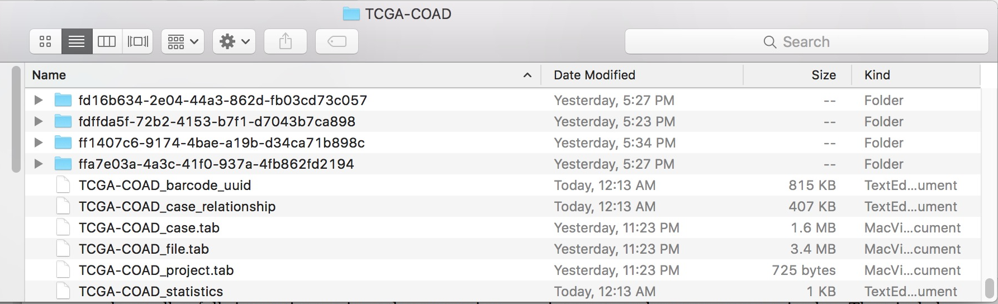
General information
The program will produce general information for files in projects and cases, relationship between UUID and barcode, and information for aliquot usage. It will also download data file separately.
Notes:
The program put information of projects, cases, and all files as project_id_type.tab, general information as project_id_statistics, barcode uuid links as project_id_barcode_uuid, aliquot usage as project_id_case_relationship.
Construct directory named case_id, put all file information of a case in it, and all download file in it seperately.

Slide 29
General information(TCGA-COAD)
File number: 9318 open 3415
Data category number: 5 open 3
Experiment strategy number: 4 open 3
access | Simple Nucleotide Variation | Raw Sequencing Data | Clinical | Biospecimen | Transcriptome Profiling
all | 3944 | 1959 | 459 | 463 | 2493
open | 0 | 0 | 459 | 463 | 2493
access | RNA-Seq | miRNA-Seq | NA | WXS
all | 2084 | 1395 | 922 | 4917
open | 1563 | 930 | 922 | 0
NA: files without experimental strategies(Clinical, Biospecimen)
Notes:
colorectal

Slide 30
General information(TCGA-COAD)
Sever workflows and experimental strategies are used for each data categories.
Notes:
Use transcirptome profiling data as an example

Slide 31
General information(TCGA-PCPG)
File number: 4227 open 2016
Data category number: 6 open 4
Experiment strategy number: 5 open 4
Acess | Transcriptome Profiling | Simple Nucleotide Variation | Copy Number Variation | Clinical | Biospecimen | Raw Sequencing Data
All | 932 | 1472 | 726 | 179 | 179 | 739
Open | 932 | 0 | 726 | 179 | 179 | 0
Access | Genotyping Array | NA | RNA-Seq | miRNA-Seq | WXS
All | 726 | 358 | 744 | 561 | 1838
Open | 726 | 358 | 558 | 374 | 0
NA: files without experimental strategies(Clinical, Biospecimen)
Notes:
Adrenal Gland

Slide 32
General information
Existence of data categories in each case (part of the table).
project_id | case_number | CNV | CNV_open | SNV | SNV_open | transcriptome | gene | gene_open | miRNA | miRNA_open | isoform | isoform_open | clinical | clinical_open | biospecimen | biospecimen_open
TCGA-PCPG | 179 | 179 | 179 | 179 | 0 | 179 | 179 | 179 | 179 | 179 | 179 | 179 | 179 | 179 | 179 | 179
TCGA-SARC | 261 | 261 | 261 | 255 | 0 | 261 | 259 | 259 | 259 | 259 | 259 | 259 | 261 | 261 | 261 | 261
TCGA-UVM | 80 | 80 | 80 | 80 | 0 | 80 | 80 | 80 | 80 | 80 | 80 | 80 | 80 | 80 | 80 | 80
TCGA-LAML | 200 | 143 | 143 | 149 | 0 | 169 | 151 | 151 | 103 | 103 | 103 | 103 | 200 | 200 | 200 | 200
TCGA-SKCM | 470 | 470 | 470 | 470 | 0 | 469 | 468 | 468 | 448 | 448 | 448 | 448 | 470 | 470 | 470 | 470
TCGA-KIRP | 291 | 290 | 290 | 288 | 0 | 291 | 289 | 289 | 291 | 291 | 291 | 291 | 291 | 291 | 291 | 291
TCGA-UCS | 57 | 0 | 0 | 57 | 0 | 57 | 56 | 56 | 57 | 57 | 57 | 57 | 57 | 57 | 57 | 57
TCGA-PAAD | 185 | 0 | 0 | 183 | 0 | 178 | 177 | 177 | 178 | 178 | 178 | 178 | 185 | 185 | 185 | 185
TCGA-LUSC | 504 | 504 | 504 | 497 | 0 | 504 | 501 | 501 | 478 | 478 | 478 | 478 | 504 | 504 | 504 | 504

Slide 33
Existence of data categories in each case (whole table).
project_id | case_number | CNV | CNV_open | SNV | SNV_open | transcriptome | gene | gene_open | miRNA | miRNA_open | isoform | isoform_open | clinical | clinical_open | biospecimen | biospecimen_open
TCGA-PCPG | 179 | 179 | 179 | 179 | 0 | 179 | 179 | 179 | 179 | 179 | 179 | 179 | 179 | 179 | 179 | 179
TCGA-SARC | 261 | 261 | 261 | 255 | 0 | 261 | 259 | 259 | 259 | 259 | 259 | 259 | 261 | 261 | 261 | 261
TCGA-UVM | 80 | 80 | 80 | 80 | 0 | 80 | 80 | 80 | 80 | 80 | 80 | 80 | 80 | 80 | 80 | 80
TCGA-LAML | 200 | 143 | 143 | 149 | 0 | 169 | 151 | 151 | 103 | 103 | 103 | 103 | 200 | 200 | 200 | 200
TCGA-SKCM | 470 | 470 | 470 | 470 | 0 | 469 | 468 | 468 | 448 | 448 | 448 | 448 | 470 | 470 | 470 | 470
TCGA-KIRP | 291 | 290 | 290 | 288 | 0 | 291 | 289 | 289 | 291 | 291 | 291 | 291 | 291 | 291 | 291 | 291
TCGA-UCS | 57 | 0 | 0 | 57 | 0 | 57 | 56 | 56 | 57 | 57 | 57 | 57 | 57 | 57 | 57 | 57
TCGA-PAAD | 185 | 0 | 0 | 183 | 0 | 178 | 177 | 177 | 178 | 178 | 178 | 178 | 185 | 185 | 185 | 185
TCGA-LUSC | 504 | 504 | 504 | 497 | 0 | 504 | 501 | 501 | 478 | 478 | 478 | 478 | 504 | 504 | 504 | 504
TCGA-READ | 172 | 0 | 0 | 158 | 0 | 167 | 167 | 167 | 161 | 161 | 161 | 161 | 170 | 170 | 172 | 172
TCGA-COAD | 463 | 0 | 0 | 433 | 0 | 459 | 456 | 456 | 444 | 444 | 444 | 444 | 459 | 459 | 463 | 463
TCGA-MESO | 87 | 87 | 87 | 83 | 0 | 87 | 86 | 86 | 87 | 87 | 87 | 87 | 87 | 87 | 87 | 87
TCGA-GBM | 617 | 593 | 593 | 396 | 0 | 166 | 166 | 166 | 5 | 5 | 5 | 5 | 596 | 596 | 617 | 617
TCGA-LGG | 516 | 514 | 514 | 513 | 0 | 516 | 511 | 511 | 512 | 512 | 512 | 512 | 515 | 515 | 516 | 516
TCGA-TGCT | 150 | 134 | 134 | 150 | 0 | 150 | 150 | 150 | 150 | 150 | 150 | 150 | 134 | 134 | 150 | 150
TCGA-UCEC | 560 | 0 | 0 | 542 | 0 | 559 | 555 | 555 | 550 | 550 | 550 | 550 | 548 | 548 | 560 | 560
TCGA-BLCA | 412 | 412 | 412 | 412 | 0 | 412 | 408 | 408 | 409 | 409 | 409 | 409 | 412 | 412 | 412 | 412
TCGA-HNSC | 528 | 0 | 0 | 510 | 0 | 528 | 501 | 501 | 524 | 524 | 524 | 524 | 528 | 528 | 528 | 528
TCGA-ACC | 92 | 92 | 92 | 92 | 0 | 80 | 79 | 79 | 80 | 80 | 80 | 80 | 92 | 92 | 92 | 92
TCGA-LIHC | 377 | 376 | 376 | 375 | 0 | 376 | 371 | 371 | 373 | 373 | 373 | 373 | 377 | 377 | 377 | 377
TCGA-THCA | 507 | 505 | 505 | 496 | 0 | 507 | 502 | 502 | 506 | 506 | 506 | 506 | 507 | 507 | 507 | 507
TCGA-BRCA | 1098 | 1096 | 1096 | 1044 | 0 | 1097 | 1092 | 1092 | 1079 | 1079 | 1079 | 1079 | 1097 | 1097 | 1098 | 1098
TCGA-OV | 608 | 572 | 572 | 442 | 0 | 492 | 376 | 376 | 489 | 489 | 489 | 489 | 586 | 586 | 607 | 607
TCGA-ESCA | 185 | 0 | 0 | 184 | 0 | 184 | 164 | 164 | 184 | 184 | 184 | 184 | 185 | 185 | 185 | 185
TCGA-CESC | 308 | 0 | 0 | 305 | 0 | 307 | 304 | 304 | 307 | 307 | 307 | 307 | 307 | 307 | 308 | 308
TCGA-PRAD | 500 | 498 | 498 | 498 | 0 | 498 | 495 | 495 | 494 | 494 | 494 | 494 | 500 | 500 | 500 | 500
TCGA-STAD | 478 | 0 | 0 | 441 | 0 | 439 | 380 | 380 | 436 | 436 | 436 | 436 | 443 | 443 | 478 | 478
TCGA-THYM | 124 | 124 | 124 | 123 | 0 | 124 | 119 | 119 | 124 | 124 | 124 | 124 | 124 | 124 | 124 | 124
TCGA-DLBC | 58 | 48 | 48 | 48 | 0 | 48 | 48 | 48 | 47 | 47 | 47 | 47 | 48 | 48 | 58 | 58
TCGA-LUAD | 585 | 518 | 518 | 569 | 0 | 519 | 515 | 515 | 513 | 513 | 513 | 513 | 522 | 522 | 585 | 585
TCGA-KICH | 113 | 66 | 66 | 66 | 0 | 66 | 66 | 66 | 66 | 66 | 66 | 66 | 113 | 113 | 113 | 113
TCGA-KIRC | 537 | 532 | 532 | 339 | 0 | 534 | 530 | 530 | 516 | 516 | 516 | 516 | 537 | 537 | 537 | 537
TCGA-CHOL | 51 | 36 | 36 | 51 | 0 | 36 | 36 | 36 | 36 | 36 | 36 | 36 | 45 | 45 | 51 | 51

Slide 34
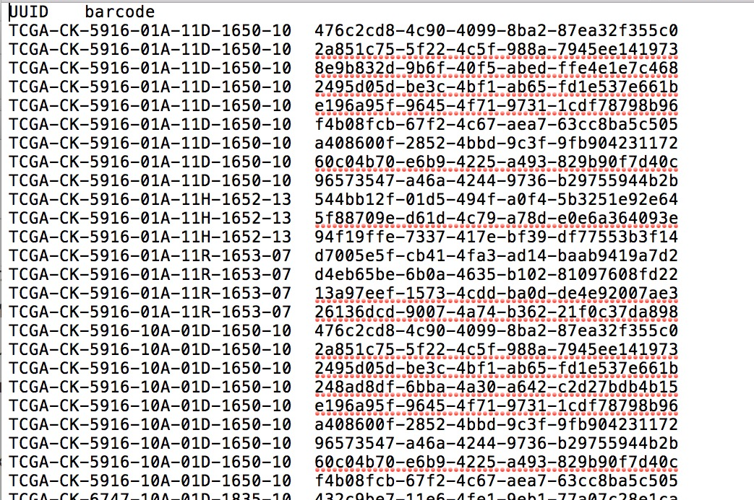
Barcode and UUID relationship
Barcode: the aliquots information.
File UUID: the file information.

Slide 35
Barcode and UUID relationship
Notes: Not all barcodes have corresponding file UUID, and sometimes relationship between barcode and file uuid are not unique(SNP).
This could be used for information search, especially for sample information of data files.

Slide 36
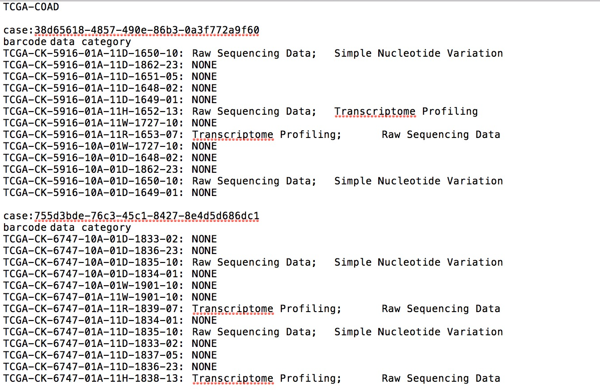
Aliquot usage
This present analysis for each aliquot.

Slide 37
Variation in Clinical data
New clinical information better arranged in TCGA but in XML format.
The new general clinical information have been combined with the old existing records.
 | GDC portal | old Clinical data
data type | Clinical supplement | Clinical supplement, image, pathology report …
cases(row) | 11160 | 8866
number of evalution(column) | 37(general) | 39-108
Attention: Clinical data here is the general summary, while a detailed one could be downloaded in XML
Notes:
Disease Test, treatment&therapy, metastasis, tissue&cell, not in details as well

Slide 38
TCGAbiolinker
It is a updated(07/28) R package for TCGA data on GDC.(query, download, analysis, visualization)
It is still under construction and with holes.
This package is good in sample selection, reformating XML, and accessing Archive.
query = GDCquery(project = paste0("TCGA-",project[i]), data.category = "Transcriptome Profiling", data.type = "Gene Expression Quantification", workflow.type = "HTSeq - FPKM-UQ", sample.type = "Primary solid Tumor") #searching
GDCdownload(query, method="client") #downloading
Colaprico et al. 2015
Notes:
New, unfinished, with holes, a little slower, and with sometimes with limited choice.
It is good for searching and downloading data.
It is unclean, with holes,
Colaprico A, Silva TC, Olsen C, Garofano L, Cava C, Garolini D, Sabedot T, Malta TM, Pagnotta SM, Castiglioni I, Ceccarelli M, Bontempi G and Noushmehr H (2015). “ TCGAbiolinks: An R/Bioconductor package for integrative analysis of TCGA data.” Nucleic Acids Research.

Slide 39
Acknowledgement
I really appreciate helps of the CSBL lab, including helps from Prof. Ying Xu, Chi Zhang, Yan Chen, Sha Cao, Tao Sheng, and so on.
Many thanks to suggestions and mentoring of Chi Zhang in this project.
Many thanks to other lab members.

Slide 40
THANKS FOR YOUR ATTENTION

Slide 41
TCGA-Archive
Attention: it seems that other Clinical data including Tissue Slide Image, Diagnostic Image, Pathology Report, Clinical Data, Biospecimen Data are not in project but put seperately.
ALL:
Tissue Slide Image(18521), Diagnostic Image(11893), Pathology Report(11132), Clinical data(1276), Biospecimen data(270)
As most data are more than 10000, it should be enough.
Lung:
TCGA-LUAD
CNV: Copy Number Segmentation, Copy Number Estimate, Normalized Copy Numbers
Gene expression: Gene Expression Quantification, Isoform Expression Quantification, Exon Junction Quantification, Exon Quantification, miRNA Gene Quantification
Raw Mircroarray: Raw Intensities, Normalized Intensities, Intensities
Raw Sequencing: Aligned Reads, Unaligned Reads
SNV: Genotypes, Simple Somatic Mutation (all only 3 open)
DNA Methylation: Methylation Beta Value, Bisulfite Sequence Alignment, Methylation Percentage
Biospecimen: Biospecimen Supplement
Clinical: Clinical Supplement
TCGA-LUSC
CNV: Copy Number Segmentation, Copy Number Estimate, Normalized Copy Numbers, LOH
Gene expression: Gene Expression Quantification, Isoform Expression Quantification, Exon Junction Quantification, Exon Quantification
Raw Mircroarray: Raw Intensities, Normalized Intensities, Intensities , Intensities Log2 Ratio
Raw Sequencing: Aligned Reads, Unaligned Reads
SNV: Genotypes, Simple Somatic Mutation (only 1 open)
DNA Methylation: Methylation Beta Value, Bisulfite Sequence Alignment, Methylation Percentage
Biospecimen: Biospecimen Supplement
Clinical: Clinical Supplement
The red ones are with open data
Notes:
The red ones are with open data
Most clinical data are stored seperately,

Slide 42
TCGA-Archive
Colon:
TCGA-COAD
Raw Sequencing: Aligned Reads, Unaligned Reads
SNV: Simple Somatic Mutation (only 2 open)
Biospecimen: Biospecimen Supplement
Clinical: Clinical Supplement
Notes:
The red ones are with open data
Most clinical data are stored seperately,

